Slide 1

18ECC302J: Microwave & Optical Communications
Point-to-Point link –Analog / Digital System design
Source:
Gerd Keiser: Optical Fiber Communications
Stavros Iezekiel; University of Cyprus
BC Choudhary, Professor, NITTTR

Slide 2
General Communications Systems Block Diagram

Slide 3
Block Diagram of Optical Communication System

Slide 5
Elements of Link/ Network Design
Transmission Types
Link – Point to Point
Elements of Link / Network Design
Transmitter
Optical Fibers
Network
Point to Multi Point
Mesh
Ring
Basic Building Blocks
Laser and LED
Optical Amplifier
Modulators
Photodetectors
Fiber
Connection
In Line Devices
Receiver

Slide 6
Elements of Link/ Network Design
Transmitter
Operating Wavelength
Connection
No. of Splice
Fiber
Single Mode Fiber / Multi-Mode Fiber (SMF/MMF)
Spool Length
Linewidth
Rise Time
Bit-rate
Power Level
Line Format
Fiber Types – SMF 28, DSF, etc
Cable Loss
Splice Loss
No. of Connectors
Connector Loss
In Line Devices
Splitter
Filter
Attenuator
Amplifier
Insertion Loss
Gain
Receiver
P(SEN), P(SAT), Rise Time

Slide 8
Choice of Operating Wavelength
Short haul links (e.g. LANs) :- use short wavelengths (e.g. 0.85 mm). Moderate fibre losses can be tolerated and the technology is cheap. By using multimode fibre, connectors are more rugged than for single mode.
Long haul links (e.g. transatlantic) :- use long wavelengths where attenuation and dispersion are low. (e.g. 1.3 μm - gives dispersion minimum, or 1.55 μm - has attenuation minimum and is compatible with optical amplifiers; dispersion-shifted fibre also available).

Slide 9
Comparison of Spectral Widths
Spectral Width
Choice of Source
Source Bandwidth
Choice of Fiber
Choice of Photodetector

Slide 10
Comparison of Spectral Widths
Choice of Source
Power- laser couples more power into single mode fibre than LED, but high-bit rate versions can be expensive and require temperature and optical power control. This makes them unsuitable for short links, unless VCSELs are considered (vertical cavity surface emitting laser).
Source Bandwidth
LEDs: 3 dB bandwidth of a few hundreds of MHz available from commercial devices.
Choice of Fibre
Multimode :- modal dispersion limited; can be used with LEDs and laser diodes (esp. VCSELs); graded index multimode fibre can achieve reasonable reduction in modal dispersion.
Spectral width :- at short wavelengths (high material dispersion) LEDs with large spectral widths might cause problems with inter-symbol interference. At 1.3 μm, we have very low dispersion fibre, which combined with low spectral width lasers allows high bit rates (e.g. 10 Gb/s and above), while dispersion management is possible at 1.55 μm
Laser diodes: up to a few tens of GHz External modulation (e.g. Mach-Zehnder modulator plus laser) to more than 100 GHz has been demonstrated.
Single-mode: No modal dispersion problems
can support > 1 Tb/s (using WDM)
small core diameter (8μm) leads to high tolerance (high price) connectors.
only used with laser diodes (high tolerance coupling)
Choice of Photodetector
PIN:- simpler construction than APD; relatively low sensitivity; available for short and long wavelengths; higher bandwidths achievable compared to APDs (up to 100 GHz)
APD:- better receiver sensitivity; temperature sensitive; high bias voltages

Slide 11
Factors for Evaluating Fiber Optic System Design
System Factor | Considerations
Type of Fiber | Single-mode or Multimode
Operating Wavelength | 780, 850, 1310 and 1550 nm
Transmitter Power | Expressed in dBm
Source Type | Laser, LED
Receiver Sensitivity and Overload Characteristics | Expressed in dBm
Detector Type | PIN Diode, ADP or IDP
System Factor | Considerations
Modulation Code | AM, FM, PCM or Digital
BER | 10⁻⁹ , 10⁻¹²
Signal to Noise Ratio | Specified in decibles
Number of Connectors | Loss increases with the number of connectors
Number of Splices | Loss increases with the number of Splices
Environmental Requirements | Humidity, Temperature, and Exposure to sunlight
Mechanical Requirements | Flammability, Indoor/Outdoor Application

Slide 12
Sample Link
Fiber
Source
Receiver

Slide 13
Optical Communication Networks are Constructed Similar To Wired and RF-Networks from Elementary Fiber-Optic Point-to-point Links:
Communication Networks (Consists of sub-networks)
Point – Point Links
Star
Bus
Ring
Signal Multiplexing – TDM or WDM

Slide 14
The Basic System Design Verification can be done through:
Optical Link Loss Budget
Key calculations in designing a simple fiber optic link is to determine launch power and receiver sensitivity
• Variables
– Environmental and aging
– Connector losses
– Cable losses
– Splices
– Amplifier
– Other components

Slide 15
Optical Power Budget

Slide 16
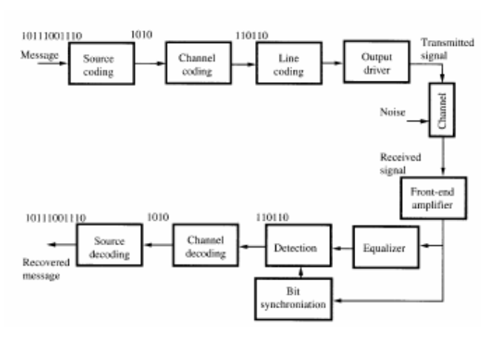
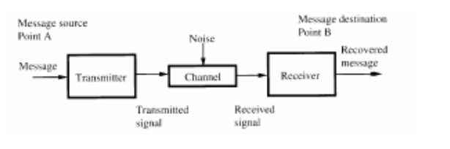
Building Blocks – Detailed Point-Pont Communication Link
Building Blocks of Elementary
Point-to-Point Link

Slide 19
Power budget in a fiber-optic link

Slide 20
Attenuation Limit

Slide 21
Dispersion-Limitations
Consider the pulse broadening Δt caused by the material-dispersion Dmat. In fibers there is an additional
dependence of the propagation vector β(ω) of the fiber mode on the fiber geometry leading to mode-dispersion Dmode . The total dispersion is approximated by the sum of the dispersions:

Slide 22
Receiver Sensitivity and Bit-Errors

Slide 23
LINK POWER BUDGET
The link power budget is an "accounting" procedure in which one calculates how much power can be lost between the transmitter and the receiver for a given receiver sensitivity (which depends on the bit rate) and transmitter power output. The resulting budget is allocated to connector losses, splice losses, fibre losses and a safety margin (system margin).
• dB and dBm units are used in the link power budget.

Slide 24
In practical applications, we often use components that have connectors attached. Fibre with one connector is known as a fibre pigtail. A length of fibre with connectors on both ends is called a patchcord.
In many link budgets, the splice loss is often combined together with the fibre loss.
We also include a safety factor known as the system margin (Ma) to account for component degradation. A typical value for Ma is 6 dB.

Slide 26
LINK RISE-TIME BUDGET
In the previous section, we saw how the maximum link distance is affected by the fibre attenuation and also the source power and the photoreceiver sensitivity for a given bit rate; this gave us the link power budget.
The total rise-time of the fibre-optic link is known as the system rise time tsys.
It depends on the rise-times of the individual systems components, and assuming these are independent of one another, they affect tsys as follows:
The usual requirement on tsys is tsys < 0.7 t, where t is pulse duration

Slide 27
Link Power Budget
Example:
Specifications: Data Rate 20 Mb/s, BER 10⁻⁹
Receiver: pin photodiode @ 850 nm → Required input signal = - 42 dBm
Optical source: GaAlAs LED with average optical power 50 µW = -13 dBm
Connector loss: 1 dB at both transmitter and receiver
System margin: 6 dB
Thus,
P_{T} = P_{S} – P_{R}
= 29 dB = 2(1 dB) + αL + 6 dB
αL = 21 dB
If α = 3.5 dB/km, then a 6-km transmission path is possible.

Slide 28
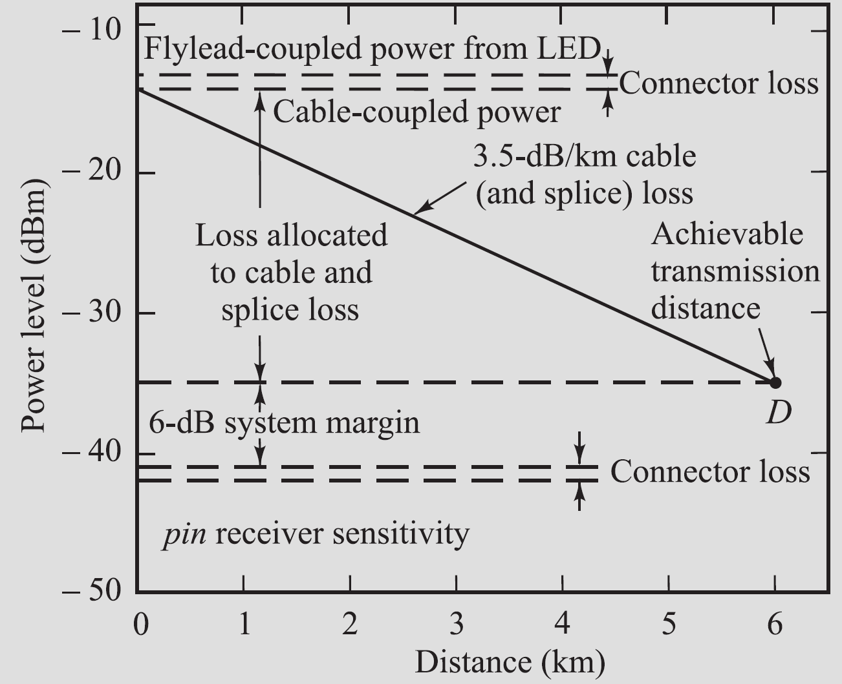
Link Power Budget
Graphical representation of a link loss budget for an 850-nm LED/pin system operating at 20 Mb/s.

Slide 29
Rise-time budget for a multimode link
Example:
Specifications: Data Rate 20 Mb/s, BER 10⁻⁹
LED : rise time 15 ns; spectral width 40 nm;
Fiber : material-dispersion related rise time 21 ns over 6 km link;
400 MHz·km bandwidth-distance product, q = 0.7 →t_{mod} =3.9 ns
Receiver : 25 MHz bandwidth → t_{rx} =14 ns
= 30 ns
For 20 Mb/s NRZ system, T_{b,NRZ} = 50 ns. Thus, t_{sys} < 0.7T_{b,NR}Z and the rise-time requirement is met.

Slide 31
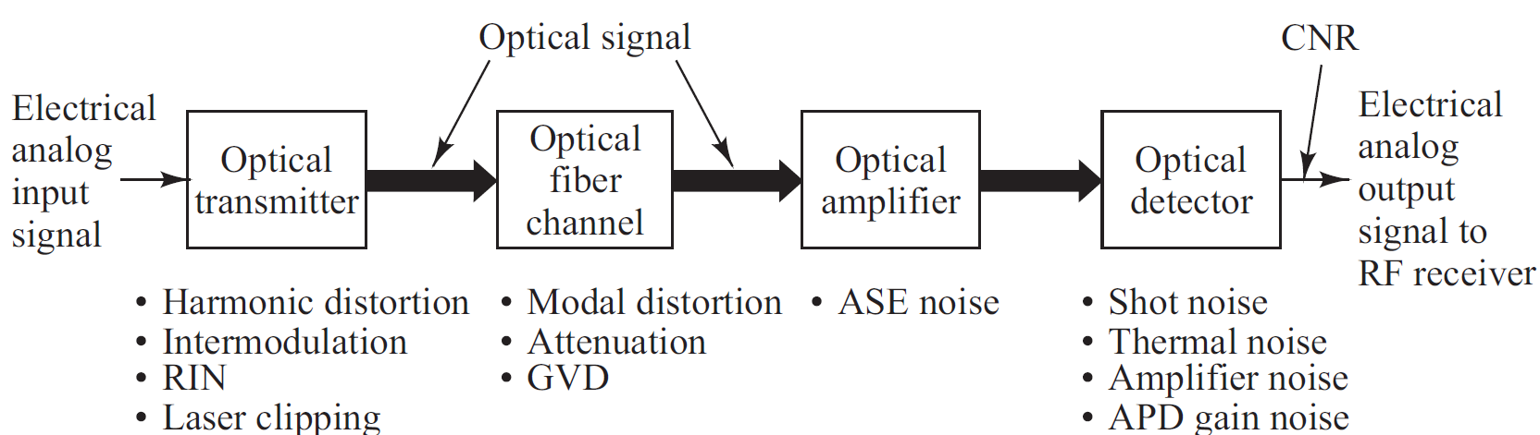
Analog Communication Links
Analog (RF) links are used where converting to digital signals is undesirable, including
• Analog TV and audio services
• Cable modem services
• Microwave-multiplexed signals (e.g., satellite base stations)
• Radar signal processing

Slide 32
Overview of Analog Links
A bias point on the source is set approximately at the midpoint of the linear output region. The analog signal can then be sent with direct intensity modulation technique.
Other modulation techniques include AM, FM and PM, which first convert baseband signal onto an electrical subcarrier prior to intensity modulation.
Signal impairments in optical source : harmonic distortions, inter-modulation (IM) products, RIN in the laser, and laser clipping.
The fiber should have a flat amplitude and group-delay response within the passband required to send the signal free of linear distortion.
Since modal-distortion-limited bandwidth is difficult to equalize, it is best to choose a single-mode fiber.

Slide 33
Radio Over Fiber (RoF) Link design and Performance Parameter

Slide 34
Radio Over Fiber (RoF)
Radio frequency (RF) signals at microwave and millimetre-wave frequencies are used in applications such as radars, satellite links, broadband terrestrial radios, and cable television networks.
The signal ranges include the
0.3- to 3-GHz ultra-high frequency (UHF) band,
3- to 30-GHz super-high frequency (SHF) region, and
30- to 300-GHz extremely high frequency (EHF) range.
Traditionally these RF systems used wireless or coaxial cable links for transporting the microwave signals from a receiving element (Ex. an antenna) to a signal processing centre, which could be located hundreds of meters away.
The methods for transmitting microwave analog signals over an optical fiber link have become known as RF-over-fiber techniques.

Slide 35
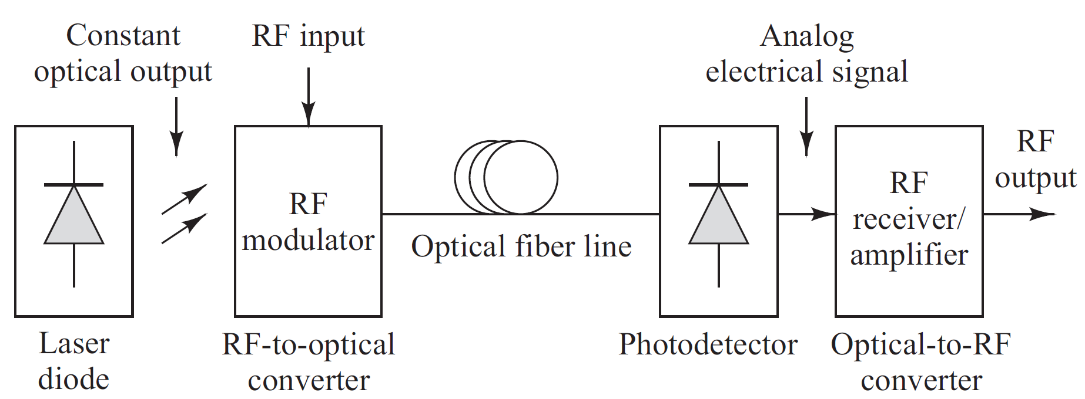
Generic RF–over-fiber Link
Fig: Basic constituents of a generic RF-over-fiber link
Three Major Modules:
An RF-to-optical signal converting device at the transmitting end,
An optical-to-RF signal converting device at the receiving end, and
An optical fiber that joins these two modules.

Slide 36
Radio Over Fiber (RoF)
Radio over fiber (RoF) refers to a technology whereby light is modulated by a radio frequency signal and transmitted over an optical fiber link.
Main technical advantages of using fiber optical links are
lower transmission losses and
reduced sensitivity to noise and electromagnetic interference compared to all-electrical signal transmission.
Applications range from the transmission of mobile radio signals (3G, 4G, 5G and Wi-Fi) and the transmission of cable television signals (CATV) to the transmission of RF L-Band signals in ground stations for satellite communications.
Access to dead zones
An important application of RoF is its use to provide wireless coverage in the area where wireless backhaul link is not possible. These zones can be areas inside a structure such as a tunnel, areas behind buildings, Mountainous places or secluded areas such as jungles.

Slide 37
RoF – for Wireless Communication
In the area of Wireless Communications one main application is to facilitate wireless access, such as 5G and Wi-Fi simultaneous from the same antenna. In other words, radio signals are carried over fiber-optic cable.
A single antenna can receive any and all radio signals (5G, Wi-Fi, cell, etc..) carried over a single-fiber cable to a central location where equipment then converts the signals; this is opposed to the traditional way where each protocol type (5G, Wi-Fi, cell) requires separate equipment at the location of the antenna.
In RoF systems, wireless signals are transported in optical form between a central station and a set of base stations before being radiated through the air.
Each base station is adapted to communicate over a radio link with at least one user's mobile station located within the radio range of said base station.

Slide 38
RoF - Advantages
The advantage is that the equipment for Wi-Fi, 5G and other protocols can be centralized in one place, with remote antennas attached via fiber optic serving all protocols. It greatly reduces the equipment and maintenance cost of the network.
RoF technology enables convergence of fixed and mobile networks.
FTTA (Fiber to the antenna)
By using an optical connection directly to the antenna, the equipment vendor can gain several advantages like low line losses, immunity to lightning strikes/electric discharges and reduced complexity of base station by attaching lightweight optical-to-electrical (O/E) converter directly to antenna

Slide 39
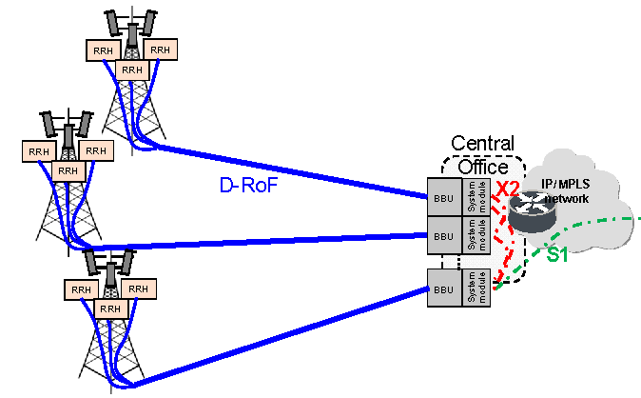
Radio over Fiber (RoF)
Radio frequency (RF) is carried over optical fiber
Between a central office (CO) and multiple low-cost remote antenna units (RAU) or radio remote head (RRH).
(RAUs) referred for microcellular radio systems
(RRHs) referred for distributed antenna system (DAS)

Slide 40
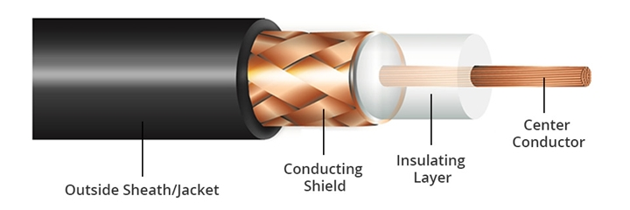
History
Coaxial copper cable carrying RF signal
Low Bandwidth (750 MHz)
Attenuation is 26dB per 30m for 750MHz bandwidth
Attenuation is 6.6dB per 30m for 50MHz bandwidth
Typical Distance of co-axial copper cable is 500m
High cost $13 per 30m
Heavy
Difficult to maintain and install due to dielectric insulating layer.
The co-axial cables are evolved as parallel copper cables like CAT5, CAT6 and HDMI cables to improve bandwidth.

Slide 41
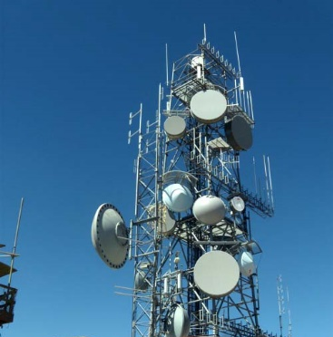
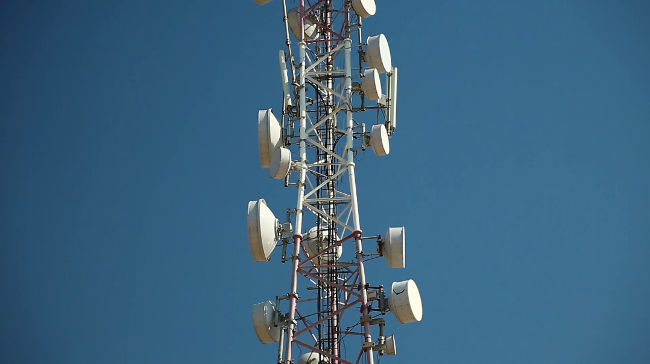
History
Microwave carrying RF signal
Moderate Bandwidth (100 GHz)
Attenuation is 10 dB/km (high dependence on channel condition and operational frequency)
Typical Distance of 3 to 5km
Line of sight to achieve high data rate.
Easy to deploy and transfer
Limited Capacity (Few Gbps)
RF signal is transmitted over µwave due to growing bandwidth demand
µwave for communication ranges from 1GHz to 100GHz
As frequency increases the transmitter and receiver module become more expensive
Link length of the system decreases, cell size decreases.

Slide 42
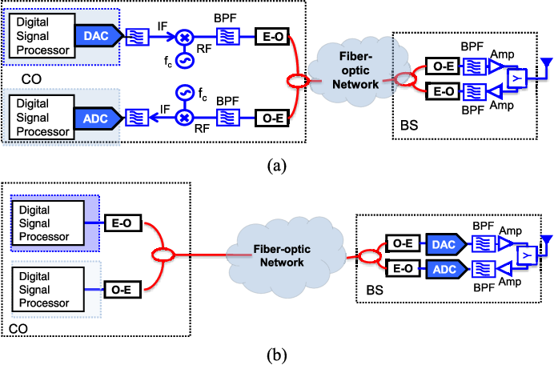
Radio over Fiber
Fiber attenuation is fixed for all the transmitting frequency typically 0.5 dB/km
Offers enormous bandwidth
Can carry up to 50km of fiber length
Signal can be distributed and processed separately
Light weight fibers quick to deploy and economic solution

Slide 43
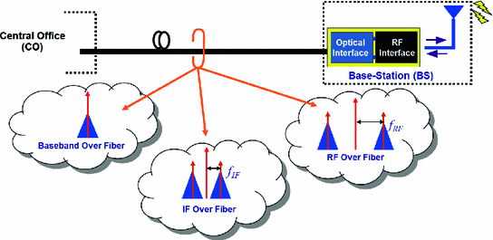
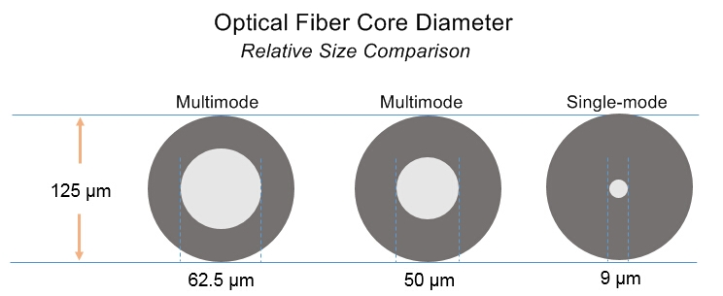
Categories of Radio over Fiber Systems
Types of Transport
RF over fiber
IF over fiber
Digitized IF over fiber or Baseband over fiber
Types of Modulation
Double sideband with carrier
Double sideband suppress carrier
Single sideband with carrier
Types of Fiber
Single mode fiber (SMF)
Multimode fiber (MMF)

Slide 44
RF - over fiber
In RF-over-fiber architecture, a data-carrying RF (radio frequency) signal with a high frequency is imposed on a light wave signal before being transported over the optical link.
Therefore, wireless signals are optically distributed to base stations directly at high frequencies and converted from the optical to electrical domain at the base stations before being amplified and radiated by an antenna.
As a result, no frequency up–down conversion is required at the various base stations, thereby resulting in simple and rather cost-effective implementation is enabled at the base stations

Slide 45
IF-over-fiber
In IF-over-fiber architecture, an IF (intermediate frequency) radio signal with a lower frequency is used for modulating light before being transported over the optical link.
Therefore, before radiation through the air, the signal must be up-converted to RF at the base station.

Slide 46
Radio Over Fiber Parameters - Link Gain
The Link Gain (G) is defined as the ratio of the RF power P_{out} generated in the photodetector load resistor to the RF power input P_{in} to the laser transmitter
For a directly modulated link, the gain is
Where
S_{M} is the slope efficiency (W/A) of the modulation device
η_{LF} is the laser to- fiber coupling efficiency
T_{F} is the fiber transmission efficiency
η_{FD} is the fiber-to-detector coupling efficiency
R is the photodetector responsivity (A/W)
R_{load} is the detector load resistance, and
R_{M} is the modulator resistance.
The two major contributors to the maximum value of the gain are
The limits of the modulator slope efficiency and
The photodetector responsivity.
The values of the other parameters do not vary significantly.

Slide 47
Radio Over Fiber Parameters - Link Gain
Typical parameter values for a 500-m RF-over-fiber link
Parameter | Symbol | Value
Slope Efficiency | S_{M} | 0.3 W/A
Coupling Efficiencies | η_{LF} and η_{FD} | 0.80
Fiber transmission efficiency | T_{F} | 0.7
Detector load resistance | R_{load} | 50 Ω
Modular resistance | R_{M} | 45 Ω

Slide 48

Radio Over Fiber Parameters – Noise Figure
The Noise Figure (NF) represents a measure of the degradation in the signal-to-noise ratio (SNR) between the input and the output of the link. It is usually defined in decibels.
where
The input noise is the thermal noise power generated by a matched resistive load k_{B}T held at T = 290°K.
The parameter k_{B} is Boltzmann’s constant and
B_{e} is the noise bandwidth of the electronic receiver.
${\overline{\text{N}}}_{\text{out}}$ denotes the total output noise power in the bandwidth B_{e} .
Since ${\overline{\text{N}}}_{\text{out}}$ is proportional to B_{e}, the N_{out} is the noise power per unit bandwidth, so that the NF is independent of the noise bandwidth.

Slide 49
Radio Over Fiber Parameters – Noise Figure
At the link output the noise power is due to the laser RIN, photodetector shot noise, and thermal noise.
Their contributions per unit noise bandwidth (in A²/Hz) are given by
where I_{p} is the average photodiode current in the receiver.
Thermal noise imposes a poorly performing limit on the SNR for low values of the photodetector current.
At higher detector currents, the RIN of the laser restricts the SNR to an upper value that cannot be exceeded even if the photodiode current is increased.

